Slide 1
Arduino-Based Weather Station Project
Real- time environmental monitoring system with blynk integration
Group 10

Slide 2
GROUP MEMBERS
Ahorlu Precious Abra Dakpe - 1815022
Asiedu Wisdom - 1818622
Oppong-Boateng Kweku Kyei - 1826122
Issac Hevi - 1822622
Sampah Allen Ekyem - 1827822
Bernard Mamphey - 1824222
Owusu Obed Afriyie - 1827022
Appiah Peter Kwame - 1817622

Slide 3
TABLE OF CONTENTS
1. Introduction & Problem Statement
2. Objectives
3. System Architecture
4. Hardware Components
5. Circuit Design & Connections
6. Software Implementation
7. Code Structure
8. Enhanced Blynk Integration (New Section)
9. System Demonstration
10. Challenges & Solutions
11. Conclusion
12. Future Improvements
13. Q&A

Slide 4
INTRODUCTION
Problem:
• Environmental monitoring is essential but traditional solutions are expensive and lack flexibility
• Limited remote accessibility of environmental data
• Need for real-time alerts for abnormal conditions
Our Solution:
• Affordable Arduino-based weather station
• Multiple sensor integration with local display and alerts
• Cloud connectivity for remote monitoring
• User-friendly interface
Why This Project?
• Real-time monitoring of environmental conditions
• Remote access using IoT
• Enhancing technical and programming skills

Slide 5
Objectives
• Design and implement a weather station that monitors:
o Temperature (°C)
o Humidity (%)
o Air Pressure (hPa – simulated via potentiometer)
• Develop a user interface with toggle display functionality
• Create a visual and audio alert system for abnormal conditions
• Enable real-time monitoring through the Blynk IoT platform
• Optimize for performance and power efficiency

Slide 6
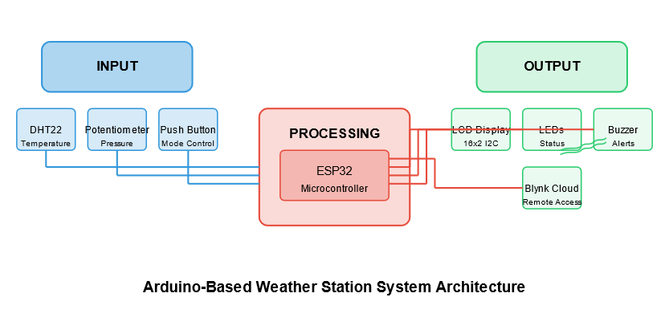
Block Diagram

Slide 7
System Architecture
Block Diagram:
•Input: DHT22 Sensor, Potentiometer (Pressure), Push Button
•Processing: ESP32 Microcontroller
•Output: LCD Display, LEDs, Buzzer, Blynk Cloud

Slide 8
Components Used
• ESP32 Microcontroller
• DHT22 Temperature & Humidity Sensor
• 16x2 I2C LCD Display
• Potentiometer (for pressure simulation)
o Note: Due to unavailability of actual pressure sensors in the EDAS lab, we substituted with a potentiometer to simulate pressure readings
• LEDs (Green, Yellow, Red)
• Buzzer
• Push Button
• Resistors & Connecting Wires

Slide 9
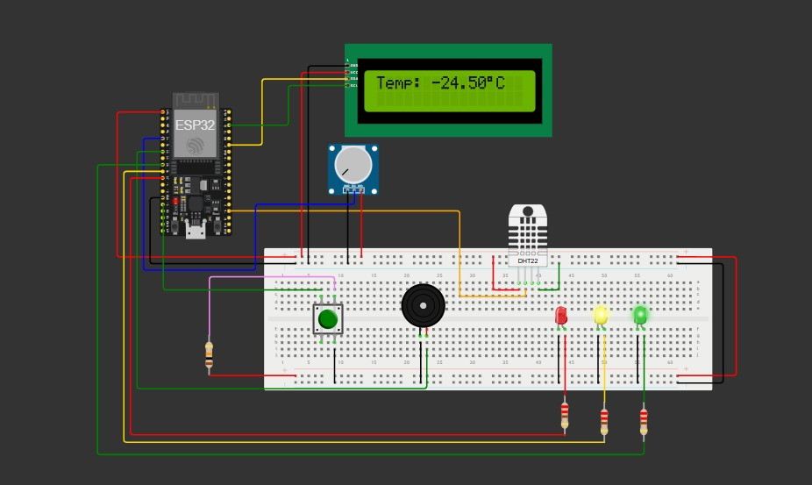
Circuit Design & Connections

Slide 10
Software Implementation
Libraries Used:
• DHT (sensor reading)
• LiquidCrystal_I2C (display control)
• WiFi & BlynkSimpleEsp32 (cloud connectivity)
Key Software Features:
1. Data Collection:
o Read temperature and humidity from DHT22
o Simulate pressure readings using potentiometer values (900-1100 hPa range)
2. Display Control:
o Use the push button to toggle between data views
3. Alert System:
o Multi-parameter monitoring with visual and audio alerts
4. Cloud Connectivity:
o WiFi connectivity & Blynk integration
5. Power Management:
o Optimizations for efficient operation

Slide 11
Code Structure
// Initialization Phase
void setup() {
// Initialize sensors, display, pins
// Connect to WiFi and Blynk
}
// Main Execution Loop
void loop() {
// Read sensor data
// Convert potentiometer reading to pressure value (900-1100 hPa)
// Update display based on mode
// Check for alert conditions
// Send data to Blynk cloud
// Handle button presses
}
// Helper Functions
void updateDisplay() { /* Display logic */ }
void checkAlerts() { /* Alert system logic */ }
void readPressure() { /* Convert analog reading to simulated pressure */ }

Slide 12
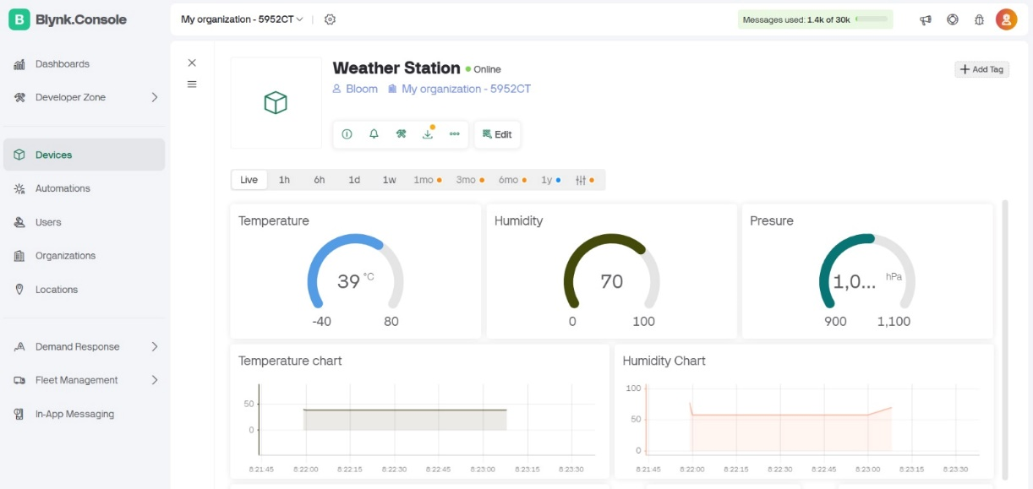
Blynk Integration
Blynk Dashboard Features:
• Real-time data visualization
• Historical data tracking
• Remote monitoring capabilities
• Alert notifications
• Virtual pin configuration
• Led widget

Slide 13
System Demonstration

Slide 14
Challenges Encountered
Technical Challenges:
• Lack of actual pressure sensor in simulators
• WiFi connectivity stability
• Button debouncing implementation
Solutions Implemented:
• Used potentiometer to simulate pressure readings
• Applied software conversion from analog values to hPa
• Created calibration routine for more accurate simulation
• Implemented debouncing for reliable button operation
• Optimized WiFi connection parameters for stability

Slide 15
Conclusion
Key Achievements:
• Successful multi-parameter monitoring system.
• Local and remote interfaces.
• Real-time alert system.
Learning Outcomes:
• Microcontroller programming.
• IoT implementation.
• Sensor integration.

Slide 16
Future Improvements
Hardware Enhancements:
•Replace potentiometer with real barometric pressure sensor (e.g., BMP280)
•Additional environmental sensors (e.g., CO2 levels)
•Solar power integration
•Custom PCB design
Software Improvements:
•Weather prediction algorithms
•Data logging capabilities for long-term analysis
•Customizable alert thresholds
•Push notifications to mobile devices
•Advanced power management

Slide 17
THANK YOU

